Slide 1

The Interaction between Self and Emotion:
An ERP study on self-positivity bias
Presenter: Hu Yilin, Bao Yiting, Xie Keqin
2024.04.22

Slide 2
Outline
Introduction
Motivation and Problem Statement
Related work
Introduction
Method
Method
Design
Procedure
Results
Results
Expected Results
Behavioral Results
Summary
Future Work
Summary
Future work

Slide 3
Motivation and Problem Statement
Self-positivity bias
Introduction
Self-positivity bias is a common psychological phenomenon in which individuals often associate positive information with themselves.
This bias enables individuals to process information related to themselves more efficiently, making self-related decision tasks easier within this bias.
The self-report method and self-reference paradigm have been most frequently used in previous studies. The investigations employ explicit self-attitude measures that can be affected by numerous factors such as self-presentation and culture.
Method
Results
Summary
Future work

Slide 4
Related work
Previous Studies
Introduction
The large number of studies on self-positivity bias indicates that people speak highly of their own intelligence, ethics , ability and insight. Meanwhile, participants responded faster to self-positive and non-self-negative words than to self-negative and non-self-positive words.
Method
Results
Summary
Cultural Differences
Future work
Much of the evidence about the self-positivity bias is from western individuals. The effect size of self-enhancement is 0.84 for Western individuals, but near 0 for Eastern individuals.

Slide 5
ERP Components
N200
Typically regarded as an index of mismatch extent with a certain cognition pattern detected automatically to input information in studies of language comprehension and decision (Fornells et al. 2006; Jonathan and Folstein 2008).
Introduction
Method
N400
Can be considered to be an important index for the extent to which self-relevant information differs from the individuals’ self-concept(Alpaugh et al. 2012).
Results
P300
Studies about the self-reference process in which an oddball paradigm was used showed that P300 was augmented for self-relevant stimuli when compared to control stimuli (Zhao et al., 2011).
Notes:
【只用念这里的话就行了，别念PPT！】Here we mainly focus on three components-N2,N400 and P300.
P300 and N400 are highly related to self-relevant information, which has been proved before.

Slide 6
Research Hypothesis
Introduction
At the behavioral level, self-related positive words and other-related negative words gain less reaction time.
At the neural level, the amplitude of N200, N400 and P300 has interaction between prime(self vs other) and emotion (positive vs negative) words
Method
Results
Summary
Future work
Notes:
OK, here comes our research hypothesis, and then comes research design.

Slide 7
Research Design
Introduction
Method
2 (prime: self of other person) x 2 (emotional valence: positive or negative) within subjects design is used.
Independent variables are prime (self or other, 2 level) and emotional valence(positive or negative, 2 level).
Dependent variables are RTs and the amplitude of N200, N400 and P300.
Results
Summary
Future work
Notes:
More details will be shown in next Method part.

Slide 8
Method
Introduction
Participants
14 healthy, right-handed Chinese participants(age 22.23±1.21)
Method
Results
Materials
Summary
Target word stimuli consisted of 20 prime words(10 self and 10 others), and 20 affective words (10 positive and 10 negative).
Future work
The whole process was performed in Psychopy with 5 Steps, among which include 2 test steps and the other practice steps.

Slide 9
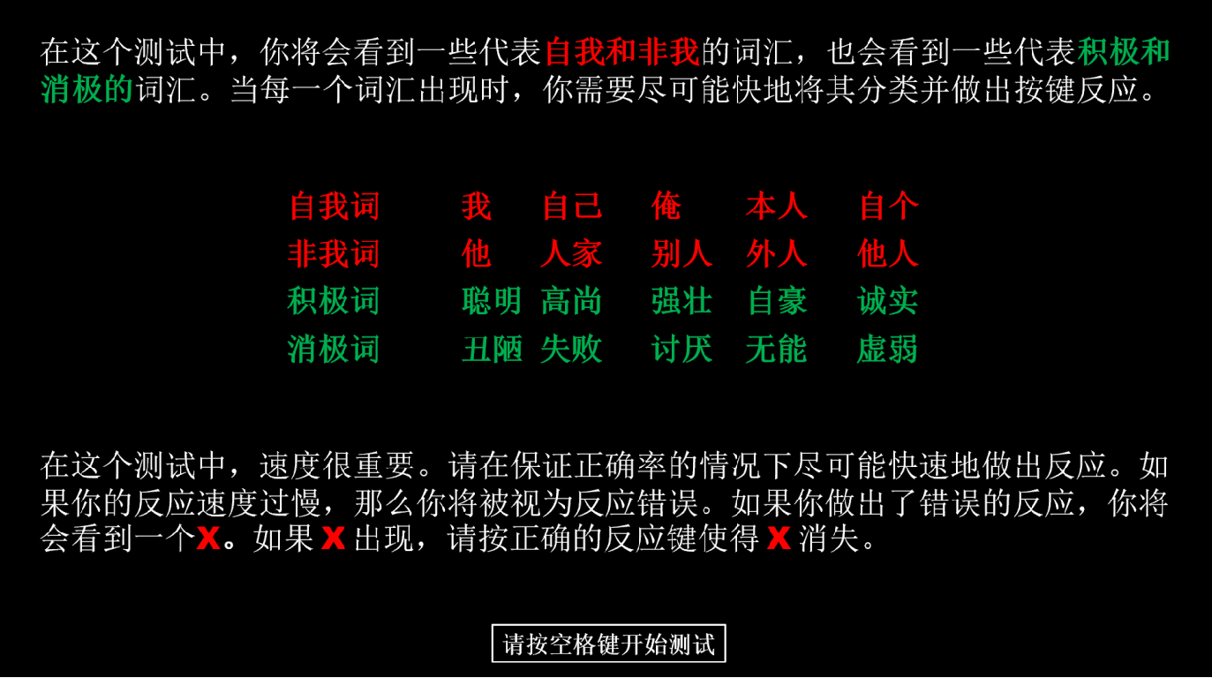
Procedure
Introduction
Method
Results
Summary
Future work
Notes:
You will see some words and then give a response by pressing the keys

Slide 10


Procedure
Introduction
Method
Results
Summary
Future work
Notes:
These are different rounds

Slide 11
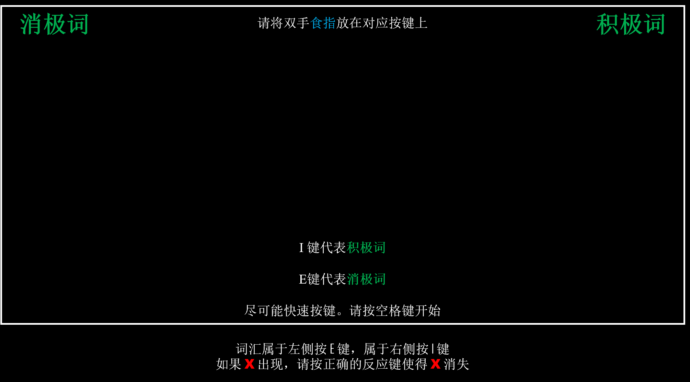
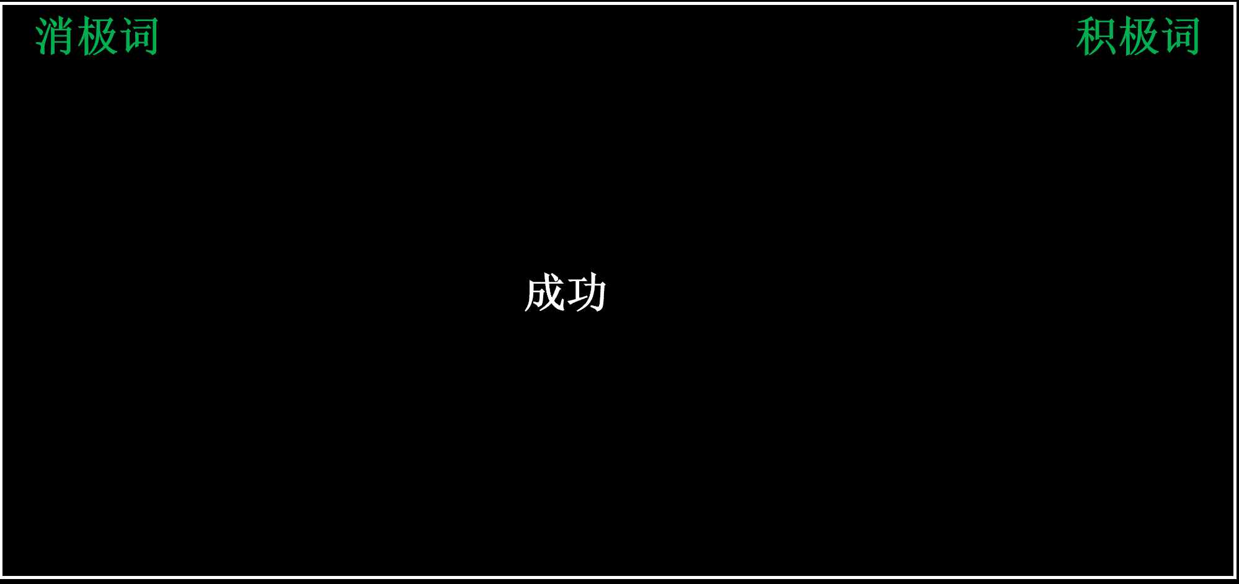
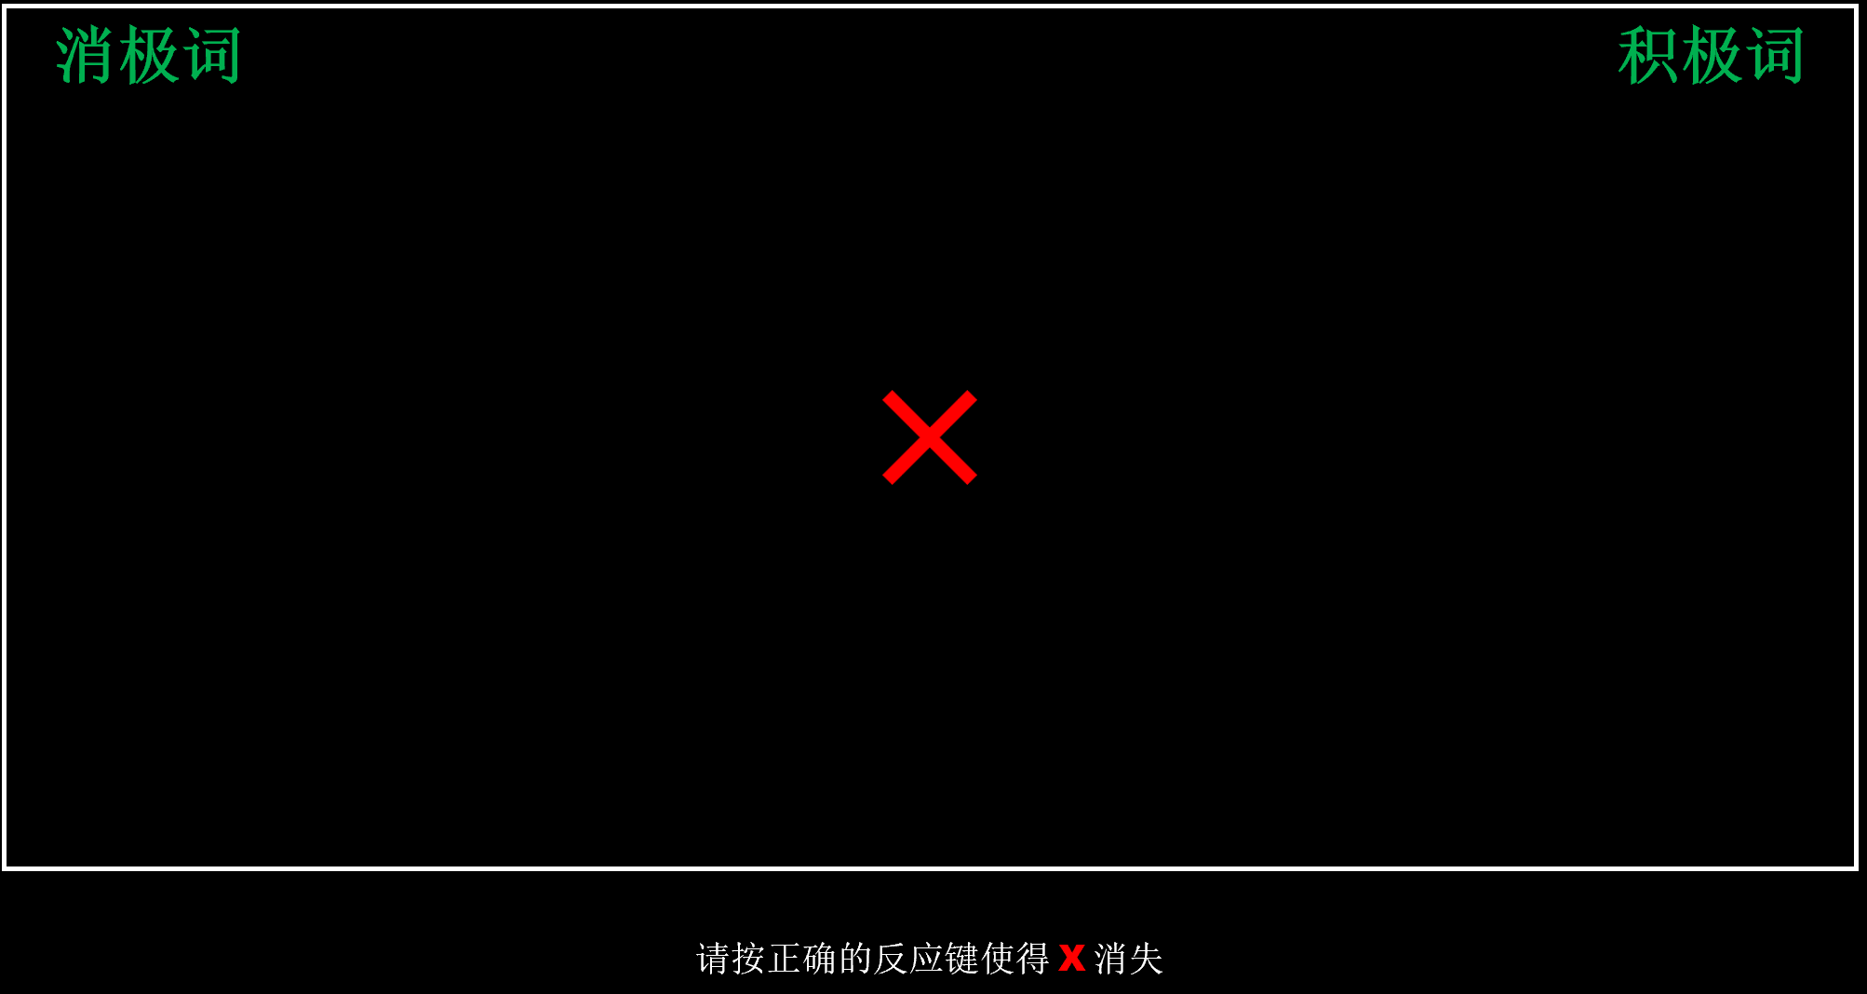
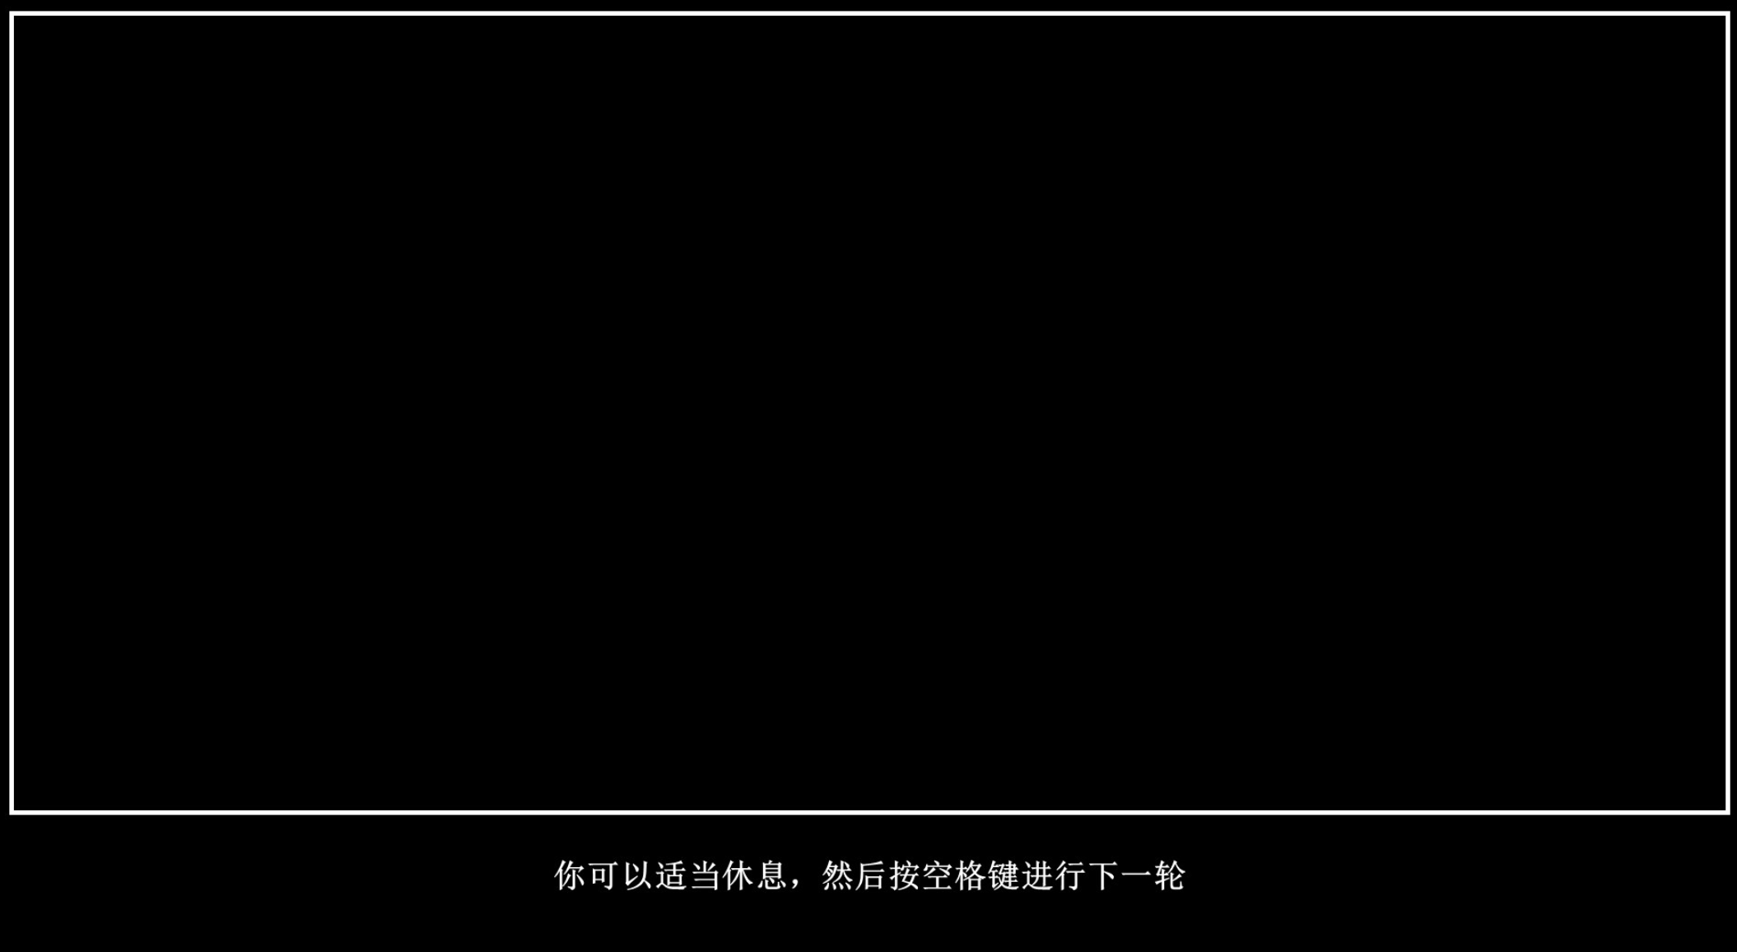
Procedure of one single trial
Introduction
Instructions
Method
Word Stimulus
& Response
Results
Feedback
Summary
Rest
Future work
Notes:
So basically, one single trial display is shown here. We can see here are introduction firstly, and the word stimulus appears. If participants react incorrectly there will be a red X, and only when they click the correct keyboard the process can go on.

Slide 12
Expected Results
Behavioral results
Introduction
A two-way repeated-measures ANOVA, including the factors prime (self vs. other person) and emotion (positive vs. negative) on RTs, will be performed.
Method
ERP results
Results
The amplitudes of N200 (100–200 ms), P300 (200–300 ms) and N400 (300–450 ms) components will be measured.
Notes:
We hope to collect behavioral date and EEG data, since the tight schedule, we only focus on behavioral part.

Slide 13
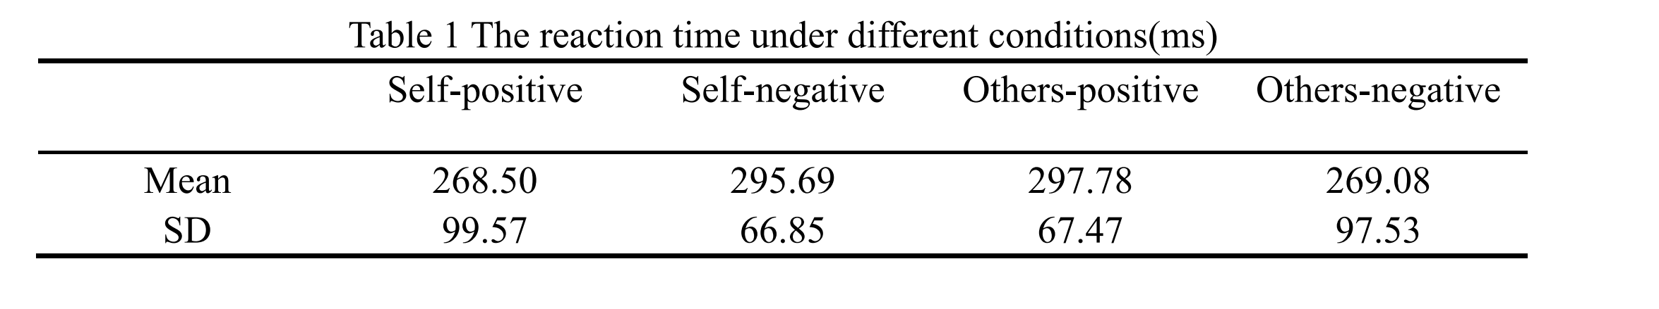
Behavioral Results
Descriptive results
Introduction
A two-way repeated-measures ANOVA, including the factors prime (self vs. other person) and emotion (positive vs. negative) on RTs, will be performed.
Method
Results
Notes:
This is a general result of reaction time, to bring more details, here comes a bar chart.

Slide 14
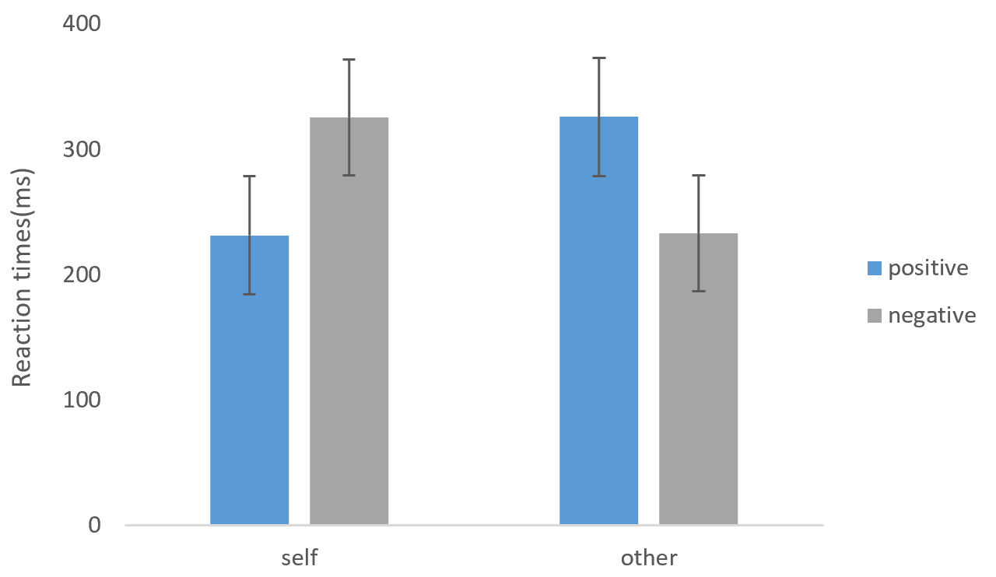
Behavioral Results
Introduction
Method
Results
Notes:
As we can see in this bar chart, self-positive association and other-negative association have lower reaction time, which comports with our hypothesis before.
Besides, it is clear that self-related information has less RT, which indicates people are inclined to make quick response to this information.
OK, let’s go on.

Slide 15
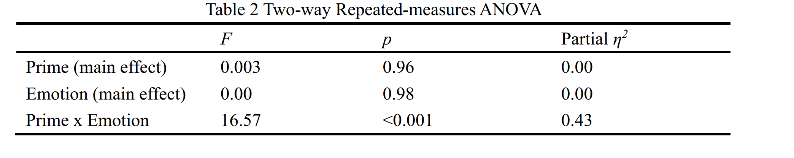
Behavioral Results
ANOVA Analysis
Introduction
A two-way repeated-measures ANOVA, including the factors prime (self vs. other person) and emotion (positive vs. negative) on RTs, will be performed.
Method
Results
The interaction is significant
Notes:
Apart from that, through ANOVA analysis, the interaction between prime and emotion remains significant. We next do the simple effects analysis.

Slide 16
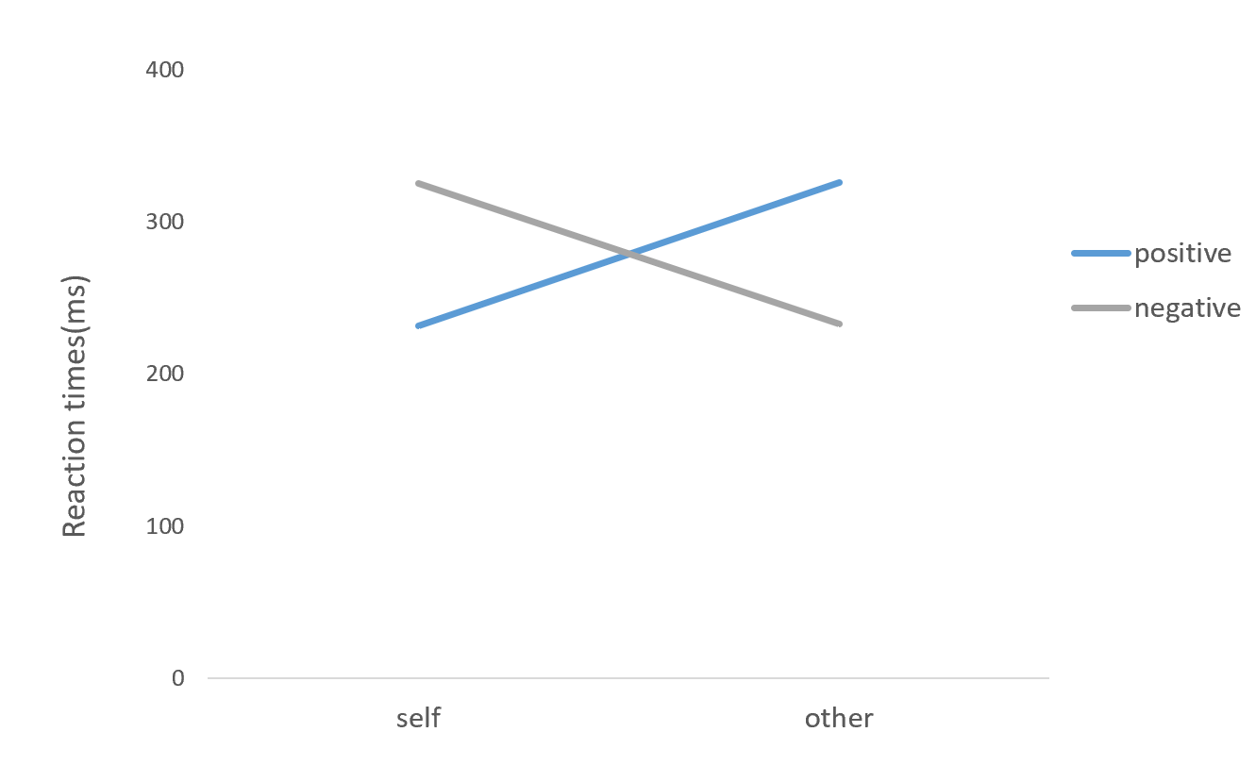
Behavioral Results
ANOVA Analysis-simple analysis
Introduction
Method
Results
Notes:
As we can see in this line graph, in the condition of self, it is apparent that positive words have less RT than negative ones;
In the condition of others, it is also obvious that negative words have less RT than positive ones;
This is one of the core findings of our study, indicating the existence of self-positivity bias at the behavioral level.

Slide 17
self-positivity bias at the implicit level
The processing of self-relevance and emotional valence is closely associated with the self-reference paradigm, and the interaction between them provides evidence for self-positivity bias.
Introduction
Method
Faster response to words within the bias than to those outside of it.
Information about self and emotional valence is processed highly dependently at implicit level.
Results
Faster response to self-priming than to other person priming.
Summary
Self consists of a highly structured mental representation and that it allows individuals to select and filter input information according to the self-schema and process information about self faster than others.
Future work
Faster response occurred to positive words than to negative ones.
Positive emotion stimuli would facilitate cognitive processing but negative emotion would not.
Notes:
The processing of self-relevance and emotional valence is closely associated with the self-reference paradigm, and the interaction between them provides evidence for self-positivity bias.
1. The interaction between prime and emotion in the reaction time confirms implicit self-positivity bias at the behavioral level, with faster response to words within the bias than to those outside of it, indicating that information about self and emotional valence is processed highly dependently at implicit level.
2. In addition, faster response to self-priming than to other person priming, which fits the self-schema theory, suggesting that self consists of a highly structured mental representation and that it allows individuals to select and filter input information according to the self-schema and process information about self faster than others.
3. Faster response occurred to positive words than to negative ones, which indicates that positive emotion stimuli would facilitate cognitive processing but negative emotion would not.

Slide 18
Participants: only 20 Chinese individuals
Introduction
Expand the sample size.
Method
May contradictory to the traditional cultural relativism
Results
The self-positivity bias is not specific to western culture. Indeed, the effect may be ubiquitous across many cultures and that prospect remains to be tested.
Summary
A random thought: Self-positivity bias can be integrated with more interesting phenomena.
Future work
Such as …
Whether those women who endorse benevolent sexism experience more positive emotion when combined “self” words with those sentences, such as women need to be protected by men, lady first… , and the neural mechanism of benevolent sexism and self-positivity bias is worth exploring.
Notes:
In this study, we only examined the self-positivity bias in Chinese students within a minimal scale. So the results just were seen as references to see a slope. In the future, we can expand the sample size.
The results may contradictory to the viewpoint of cultural relativism that characterizes the self positivity bias as a uniquely western phenomenon, and it is absent or strongly attenuated in non-western cultures. So the prospect remains to be tested.
Meanwhile, we have a random thought. In our daily life, we can see or hear those, such as: lady first. We even don’t realize that sometimes the benevolent sexism we holds. We just accepted that without consideration. So I am curious about whether those women who endorse benevolent sexism experience more positive emotion when combined “self” words with those sentences, such as women need to be protected by men, lady first… , and the neural mechanism of benevolent sexism and self-positivity bias is worth exploring.

